Slide 1

Evaluation of hail proxies in Aus400
Tim Raupach¹, Joshua Soderholm², Alain Protat², Steve Sherwood¹
1. UNSW Sydney Centre for Climate Change Research 2. Australian Government Bureau of Meteorology
^{t.raupach@unsw.edu.au} ^{@timraupach}
ACCESS Science Days, 10-11 June 2021

Slide 2
Hail proxies
A certain resolution is required for “convection-resolving” models in which you can see when hail forms.
At lower resolution? Hail proxies indicate if atmosphere is likely to produce hail.
Proxies are often a combination of wind shear (S06) and convective instability (CAPE).
A hail-prone atmosphere most often does not produce hail. This is the “initialisation problem”.

Slide 3
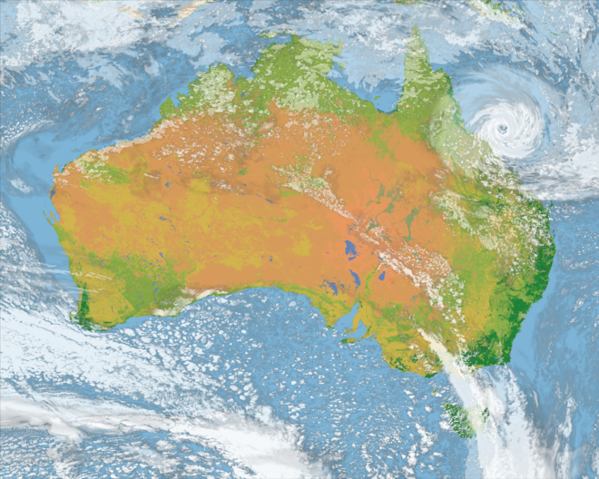
The Aus400 simulations
RA2M model run for whole of Australia.
400 m and 2.2 km resolutions.
48 hours simulation time.
2.2 km run: 5 ensembles, 90 levels.
March 2017, landfall of Cyclone Debbie.
Opportunity to look at convective-permitting resolution fields for entire continent.
Here I show one 2.2 km ensemble.
Was any hail simulated?
Aus400 cloud cover, from http://climate-cms.wikis.unsw.edu.au/Aus400.

Slide 4
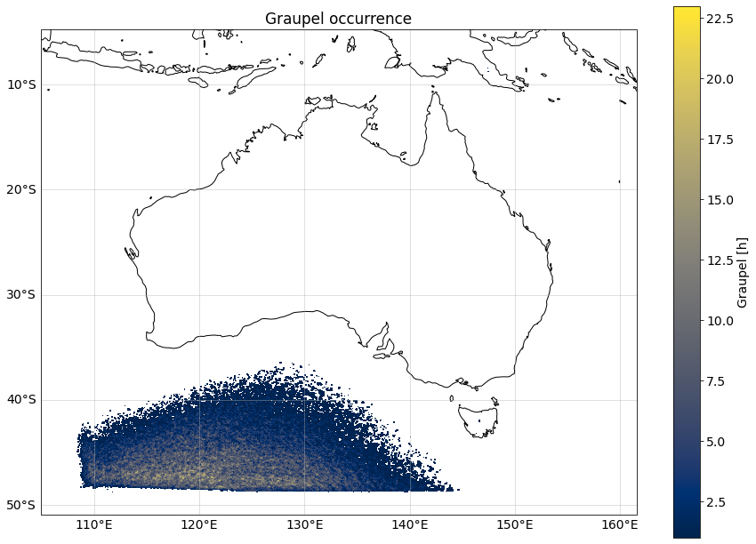
Simulated hail
Graupel mixing ratio in lowest model level used to calculate graupel size distribution and graupel rate.
Number of hours with graupel rate > 0.1 mm h⁻¹.
Very little graupel or hail!
Also no reports of hail in the BOM severe weather database.

Slide 5
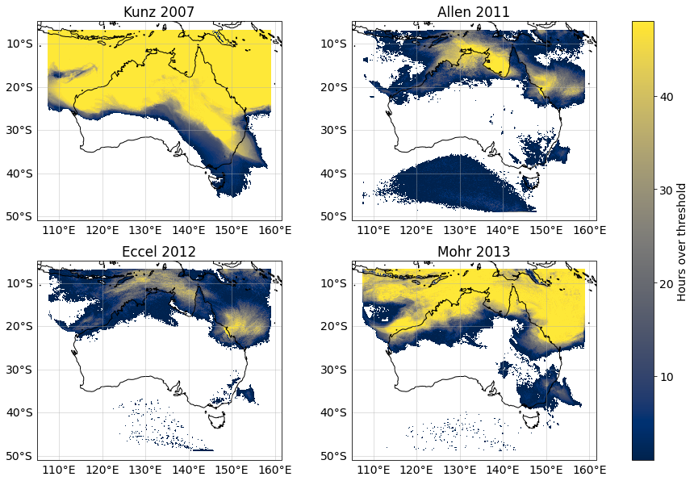
Hail proxies
Kunz 2007
Germany
Lifted index, deep convective index, CAPE
Allen 2011
Australia
CAPE, shear
Eccel 2012
Italy
CAPE, shear, CIN
Mohr 2013
Europe
Lifted index, CAPE

Slide 6
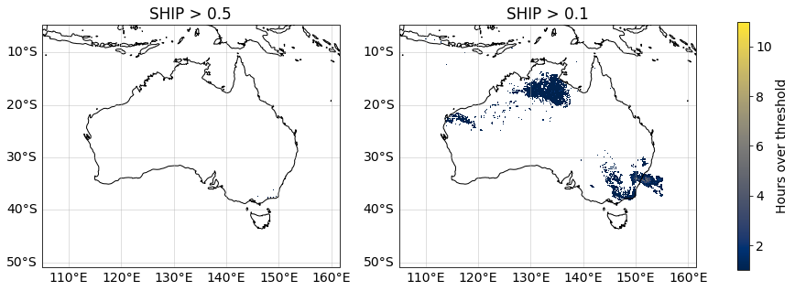
Significant hail parameter
SHIP = significant hail parameter
Calculated using CAPE, mixing ratio, 700-500 hPa lapse rate, 500 hPa temperature, shear.
Values over 1 indicate environment prone for significant hail.
Used by Prein et al., 2018 for global hail probability map.

Slide 7
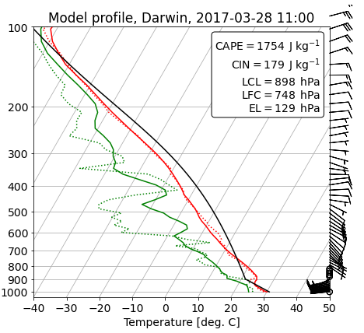
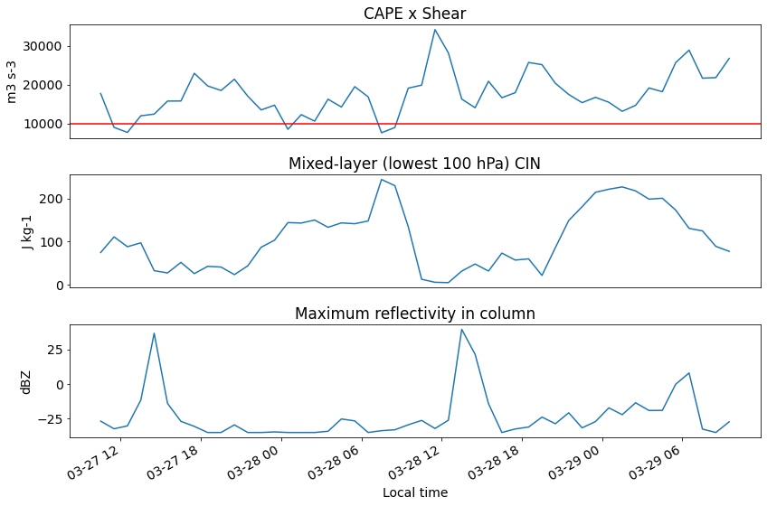
Example profile
At this time, 3 of 4 proxies triggered as storm-prone (exception was Eccel 2012).
Temperature inversion at 900 hPa.
Darwin, 20:30 local time
Timeseries for E. Melville Island

Slide 8
Conclusions and future work
Hail proxies are non-trivial, because of the initiation problem.
Care required when using CAPE and shear in Australia/tropics.
Need to factor effects of low-level inversions.
Future work: how to create a robust proxy?
t.raupach@unsw.edu.au @timraupach
Thanks!

Slide 9
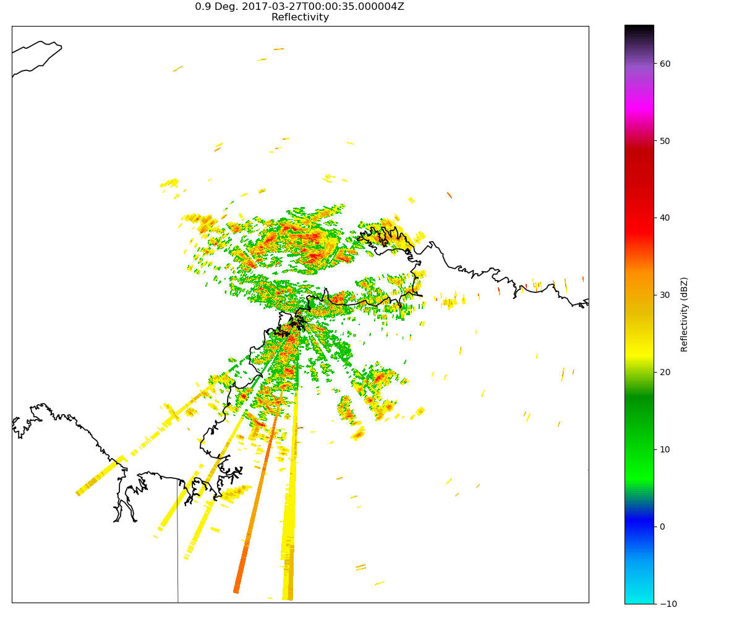
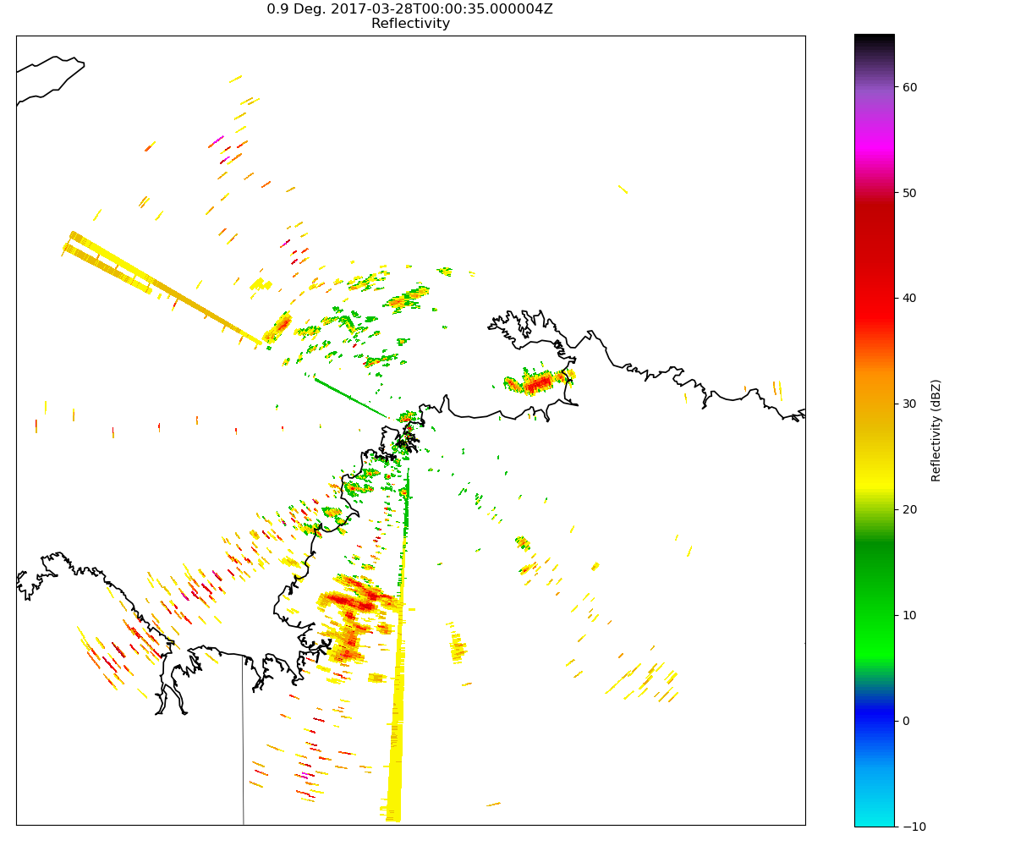
Extra slide: radar example
Max reflectivity in Darwin for 27.03.2017.
Shows that there was precipitation but no reflectivities high enough for hail (> 60 dBZ).

